Slide 1
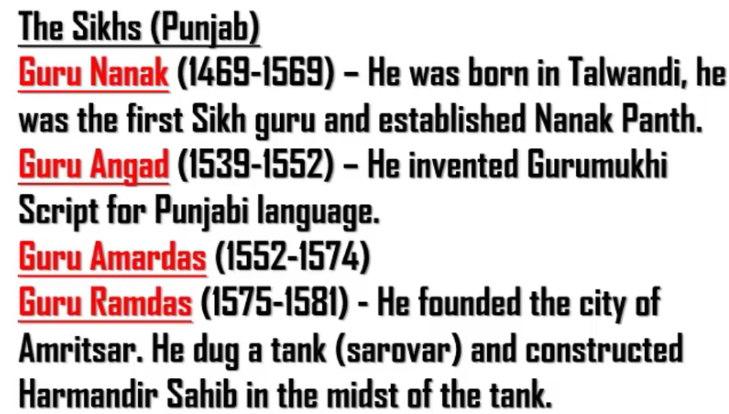
All the above gurus are from Punjab.
Therefore, Talwandi is in Punjab (But during the above mentioned Sikh gurus, this place was in Pakistan)

Slide 2
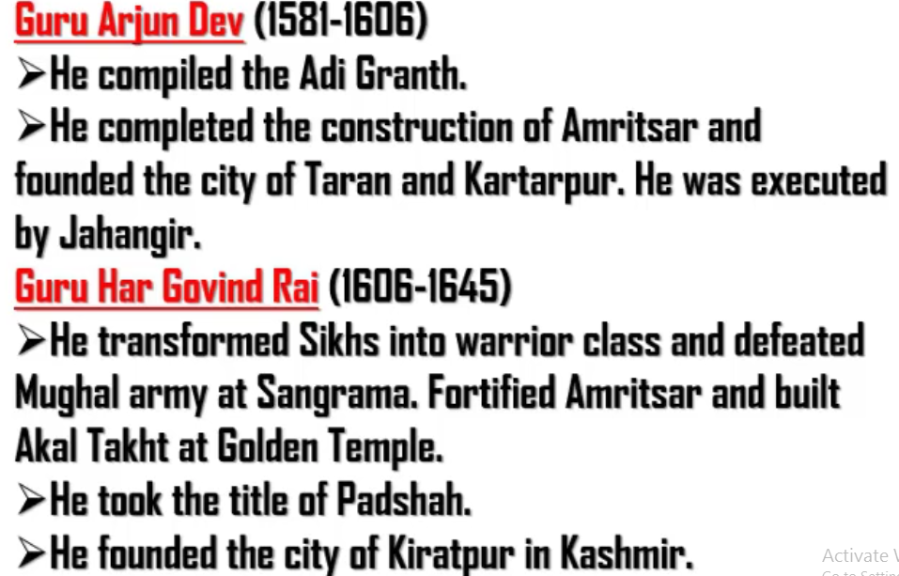

Slide 3
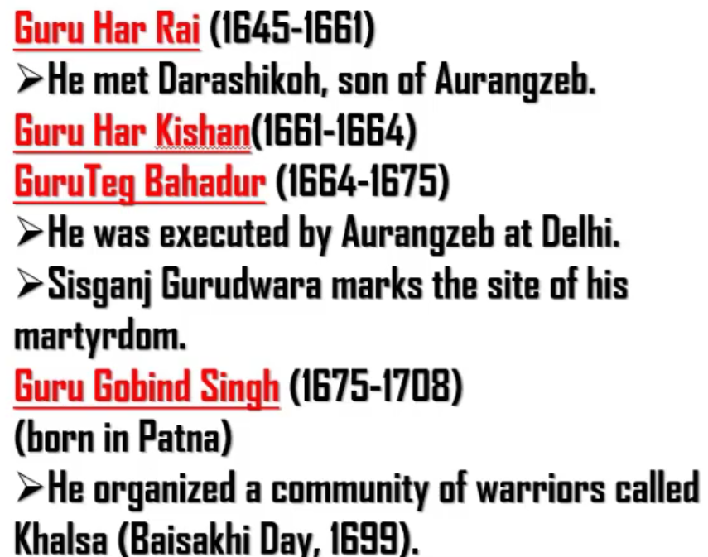
Khalsa was started on Baisakhi day

Slide 4
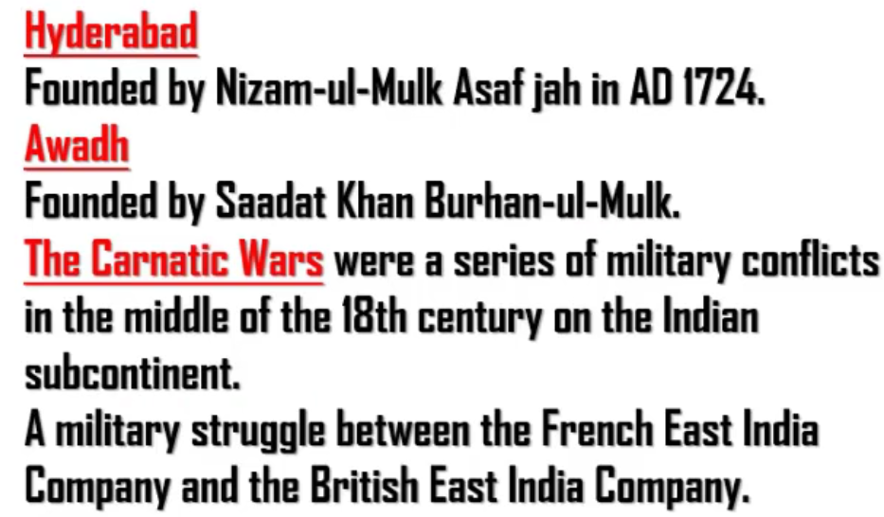

Slide 5
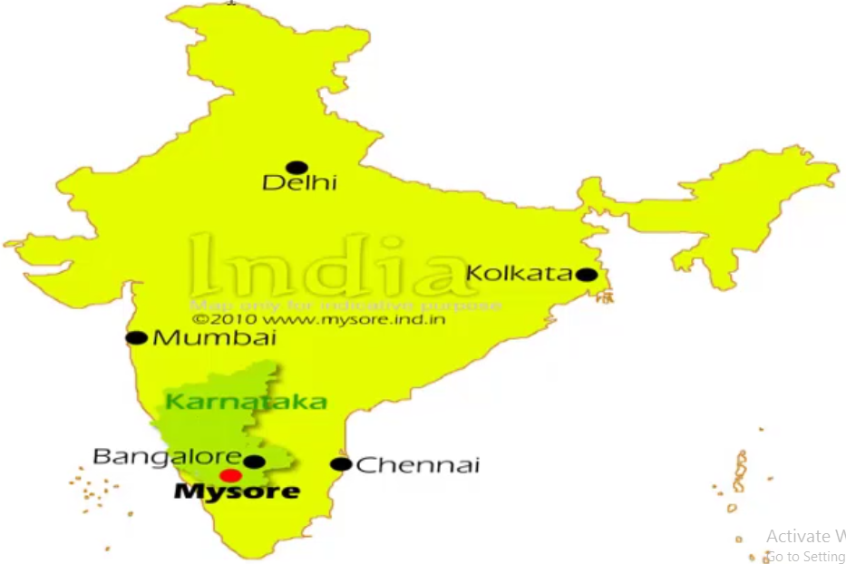

Slide 6
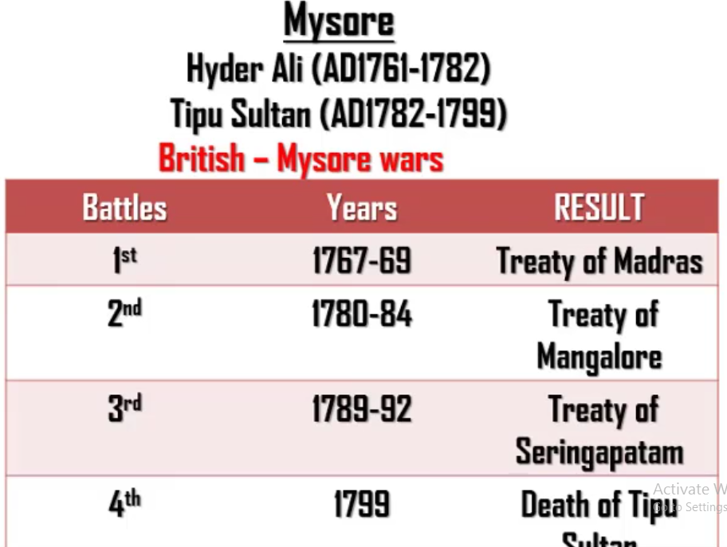
It’s been told that Haider Ali was an illeterate. But he was a brave ruler.
Haider Ali fought 1st and half of the 2nd battle of Mysore. (Haider Ali died in 1782)
Second half of 2nd battle of Mysore, 3rd battle of Mysore and 4th battle of Mysore was fought by Tipu Sultan
In the third battle of Mysore, two other Indian rulers supported British. So Tipu last and had to sign the treaty of Seringapatam. According to the treaty, Tipu gave his two sons to serve British.
In fourth battle of Mysore, Tipu died because of back stabbing by his minister.

